Slide 1





Smart Traffic Management

Slide 2

Fact
It is predicted that by 2040, a whopping 1 billion extra cars will join the 1.2 billion already on the road.

Slide 3
Contents
1
PROBLEM STATEMENT
2
PROJECT DESCRIPTION
3
COMPONENTS
4
WORKING
5
FUTURE SCOPE

Slide 4
PROBLEM STATEMENT
Traffic congestion is a main problem with foremost cities. In India the traffic lights are based on timing system i.e. whether the vehicles are present or not the timing will remain constant which makes people to wait unnecessarily for longer time.
In Emergency cases (VIP’s) or ambulance the signals are sent through Blynk Software.

Slide 5
PROJECT DESCRIPTION
The basic idea behind the project is to reduce the traffic jams with the help of Embedded device and IOT. Due to the increase in demand for Vehicles, up brings more traffic jams and thus is a major factor in slow development of the country .
Our main purpose is to decrease the time of red light according to traffic on the road which was detected by IR Sensors.
Our another purpose is that the project can also detect car which cross the zebra crossing ,in case mail will be send to traffic police and also to person on whose name the car is registered also get the mail of crossing the red light and the traffic police can capture him.
We also work for emergency vehicles like ambulance , police van when any of these vehicles are on road so the light became green automatically by the help of inbuilt WIFI system .
So we need a system that can handle the traffic effectively.
So for this we make a sustainable project by implementing some Sensors we can prevent such traffic jams. Sensor such as IR,SEVEN SEGMENT DISPLAY,NODE MCU has been used.

Slide 6
PROJECT PURPOSE
Smart Traffic Management is mainly improvised for looking after looking the set of data of a region to manage the traffic along the area and implement various useful technologies which are being required by various persons like vehicles owners, pedestrian ,police officer, etc.
Mainly the purpose of Smart Traffic Management System is to give the details which can be used and they can be implemented in daily life, the problem which have been offered at their presence can be solved by this Smart Traffic management System.

Slide 7
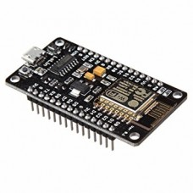
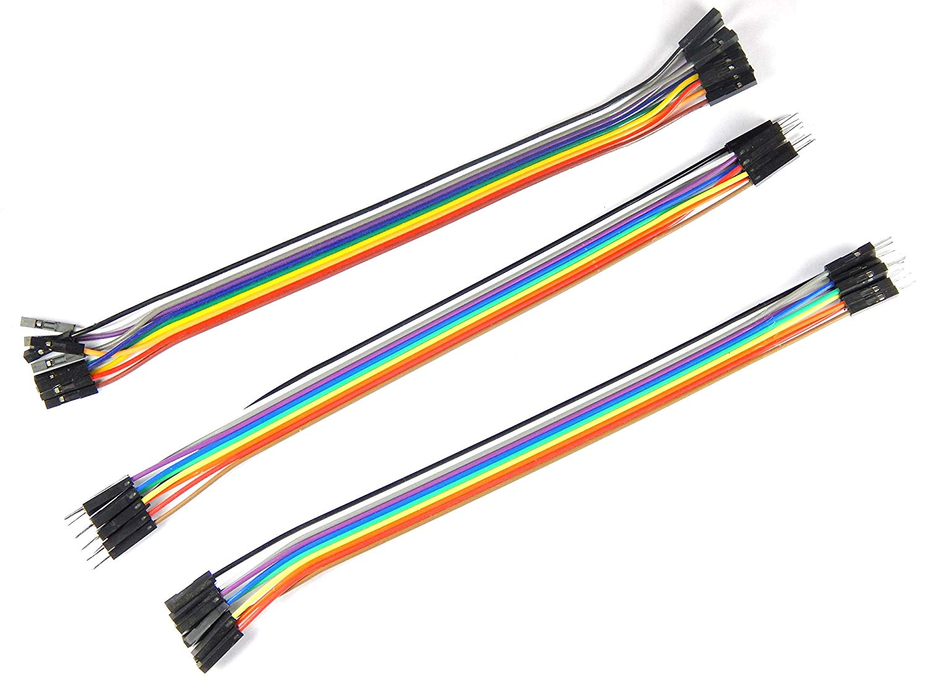
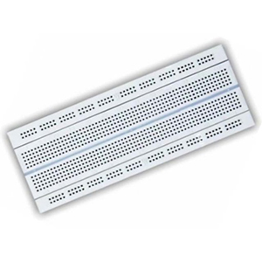
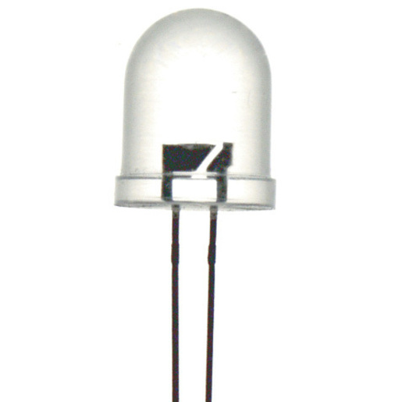
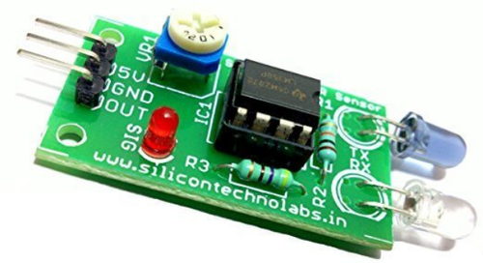
COMPONENTS USED
Fig: Jumping Wires
Fig: Node MCU
Fig: Led
Fig: IR Sensor
Fig: Bread Board

Slide 8
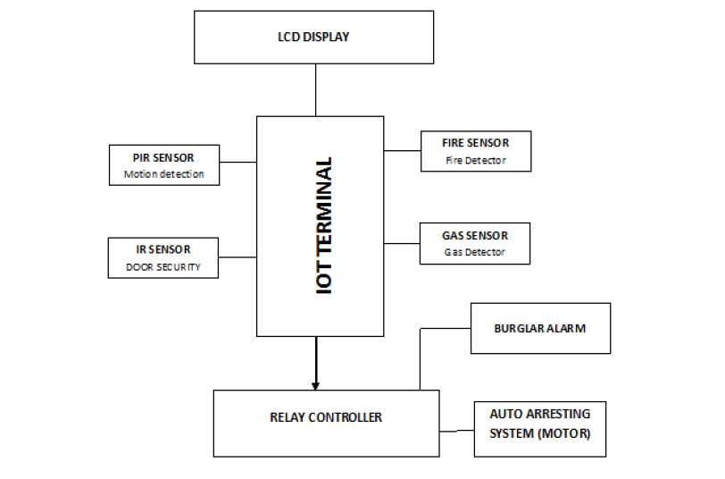
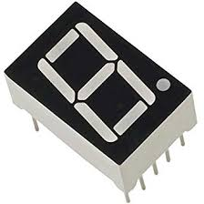
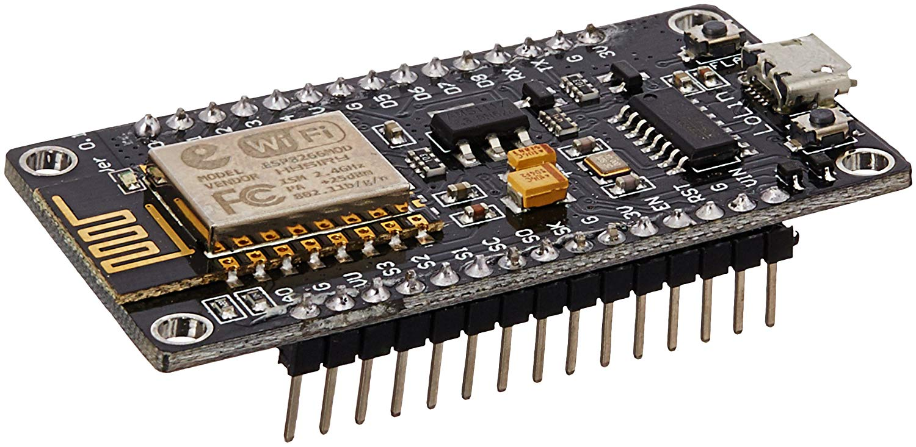
BLOCK DIAGRAM
INFRARED SENSOR
7-SEGMENT
NODE-MCU
LED

Slide 9
WORKING OF SMART TRAFFIC MANAGEMENT SYSTEM
The project methodology based on the concepts of IOT and EMBEDDED. How we can control the increasing amount of traffic and also to capture the person who cross the traffic light.
IR sensor is used here which catches the light beam after striking the object produced when any vehicle cross over it by pass the infrared rays and by collecting the data we can set the time limit of green light
The prototype can also be detect car which cross the zebra crossing by that in case mail will be send to traffic policeman and also to person on whose name the car is registered also get the mail of crossing the red light and the traffic policeman can capture him.
For emergency vehicles like ambulance , police van etc. we can do first green the light of the road on which emergency vehicle is standing by the use of WIFI model.

Slide 10
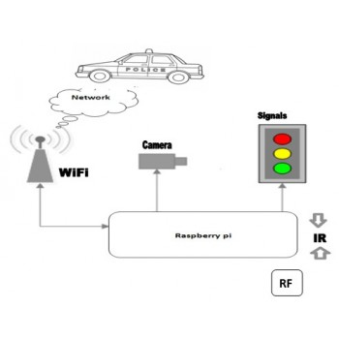
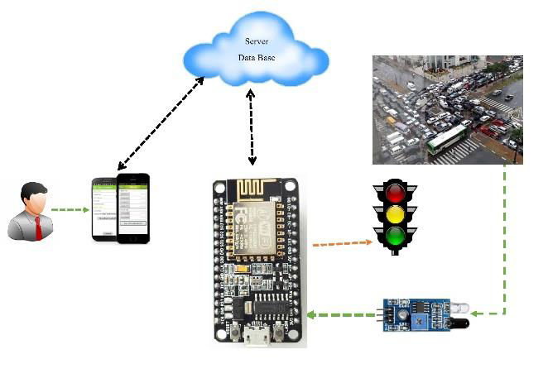
NODE MCU

Slide 11
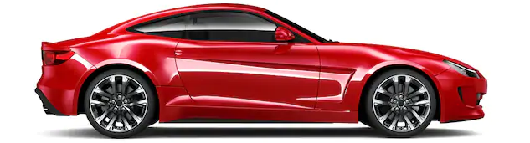
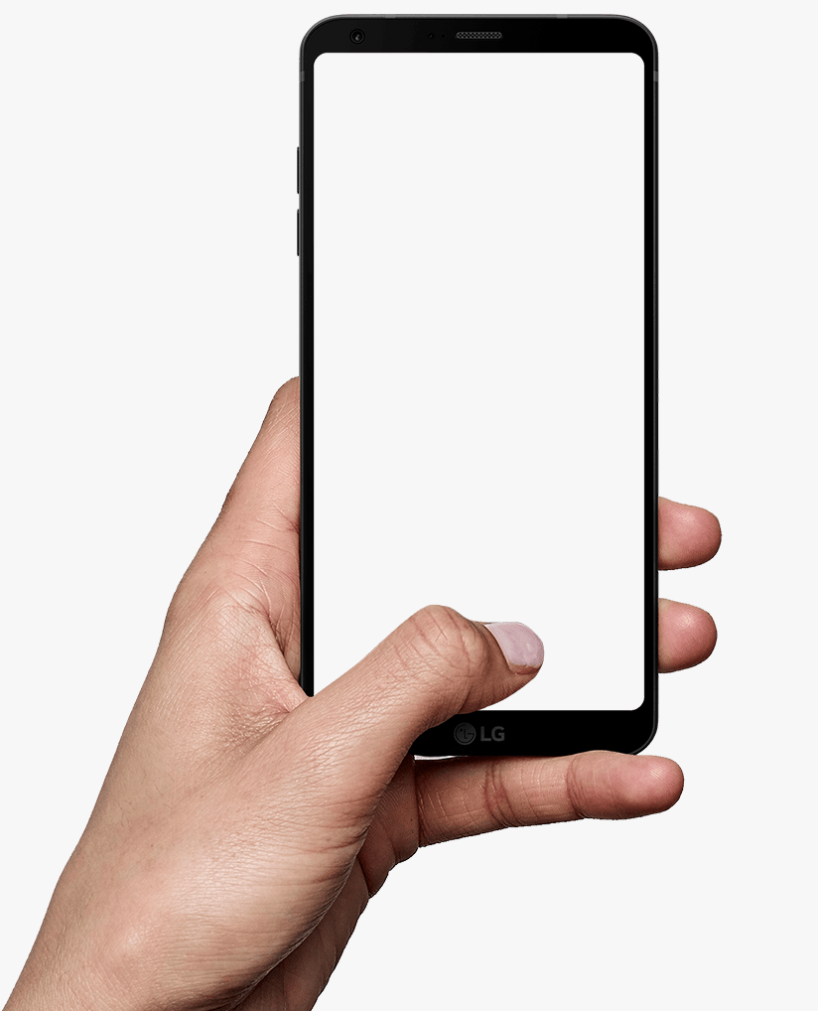
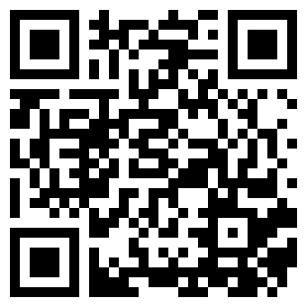
We can also scan QR Code
which will contain details of
the car owner and much info.
Scanning

Slide 12
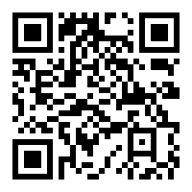

Car
Ambulance

Slide 13
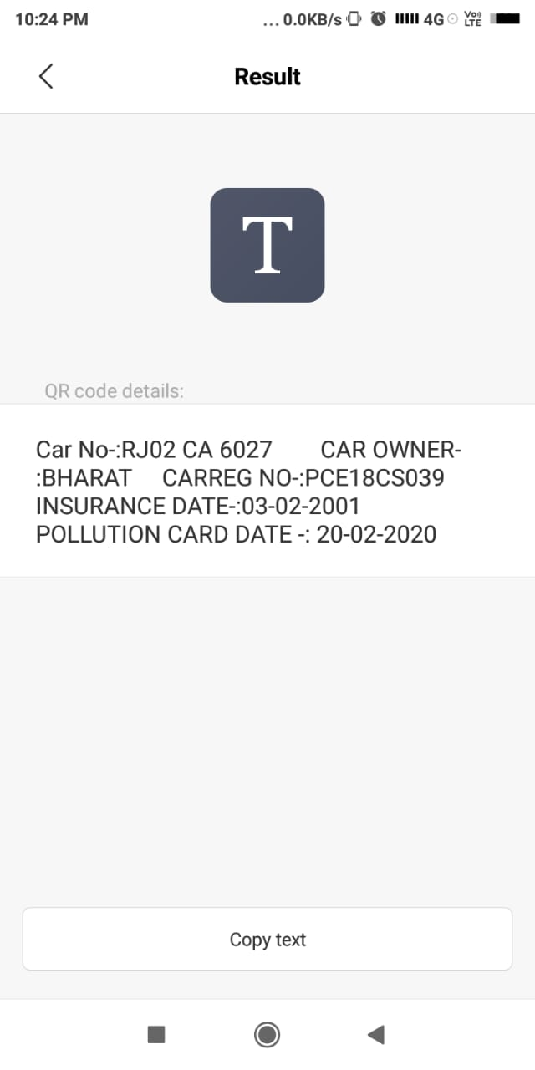
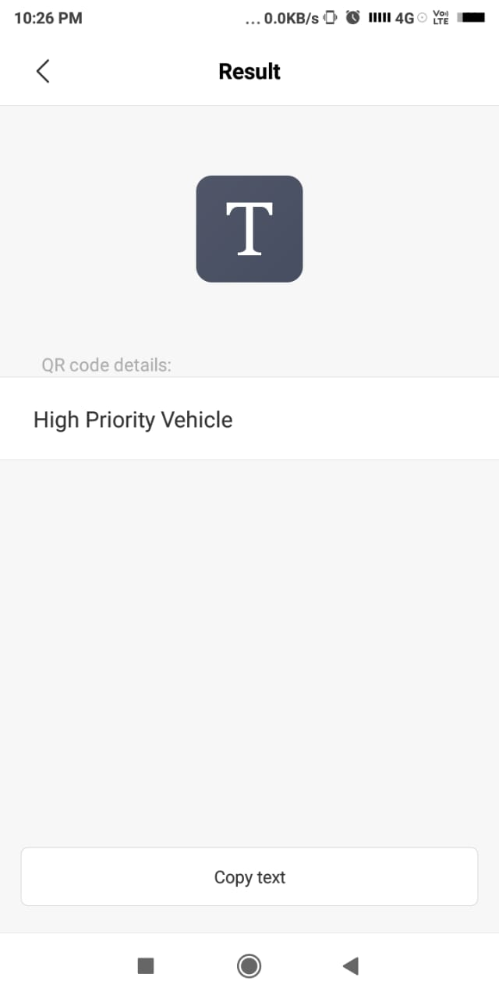
Outcome of QR code

Slide 14
FACT
In 2010, a traffic jam on a highway near Beijing kept cars stuck in traffic for more than a week (9-12 days according to different sources). The traffic jam itself went on for 97 kilometres.

Slide 15
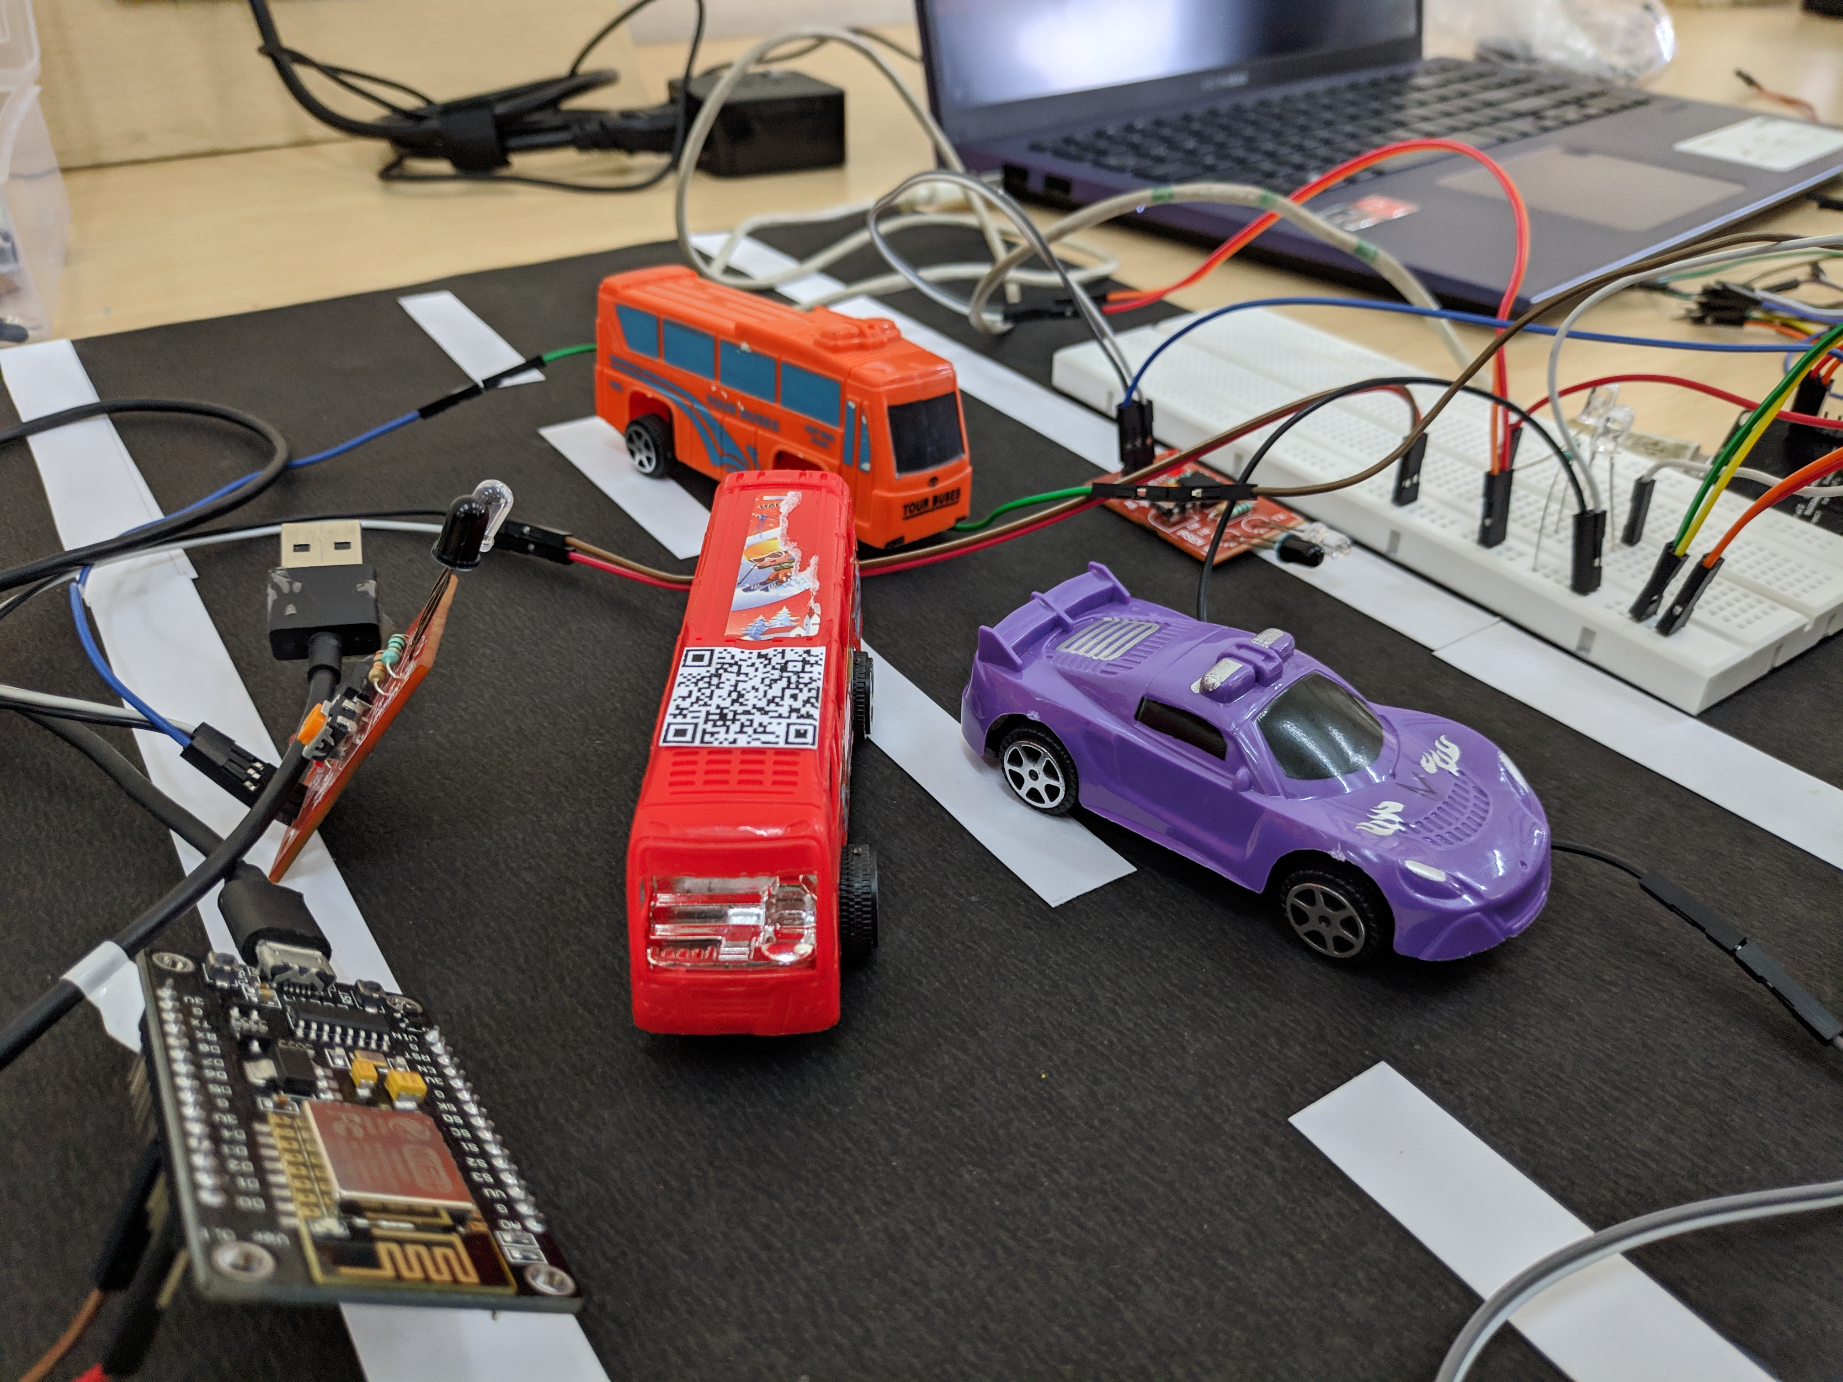
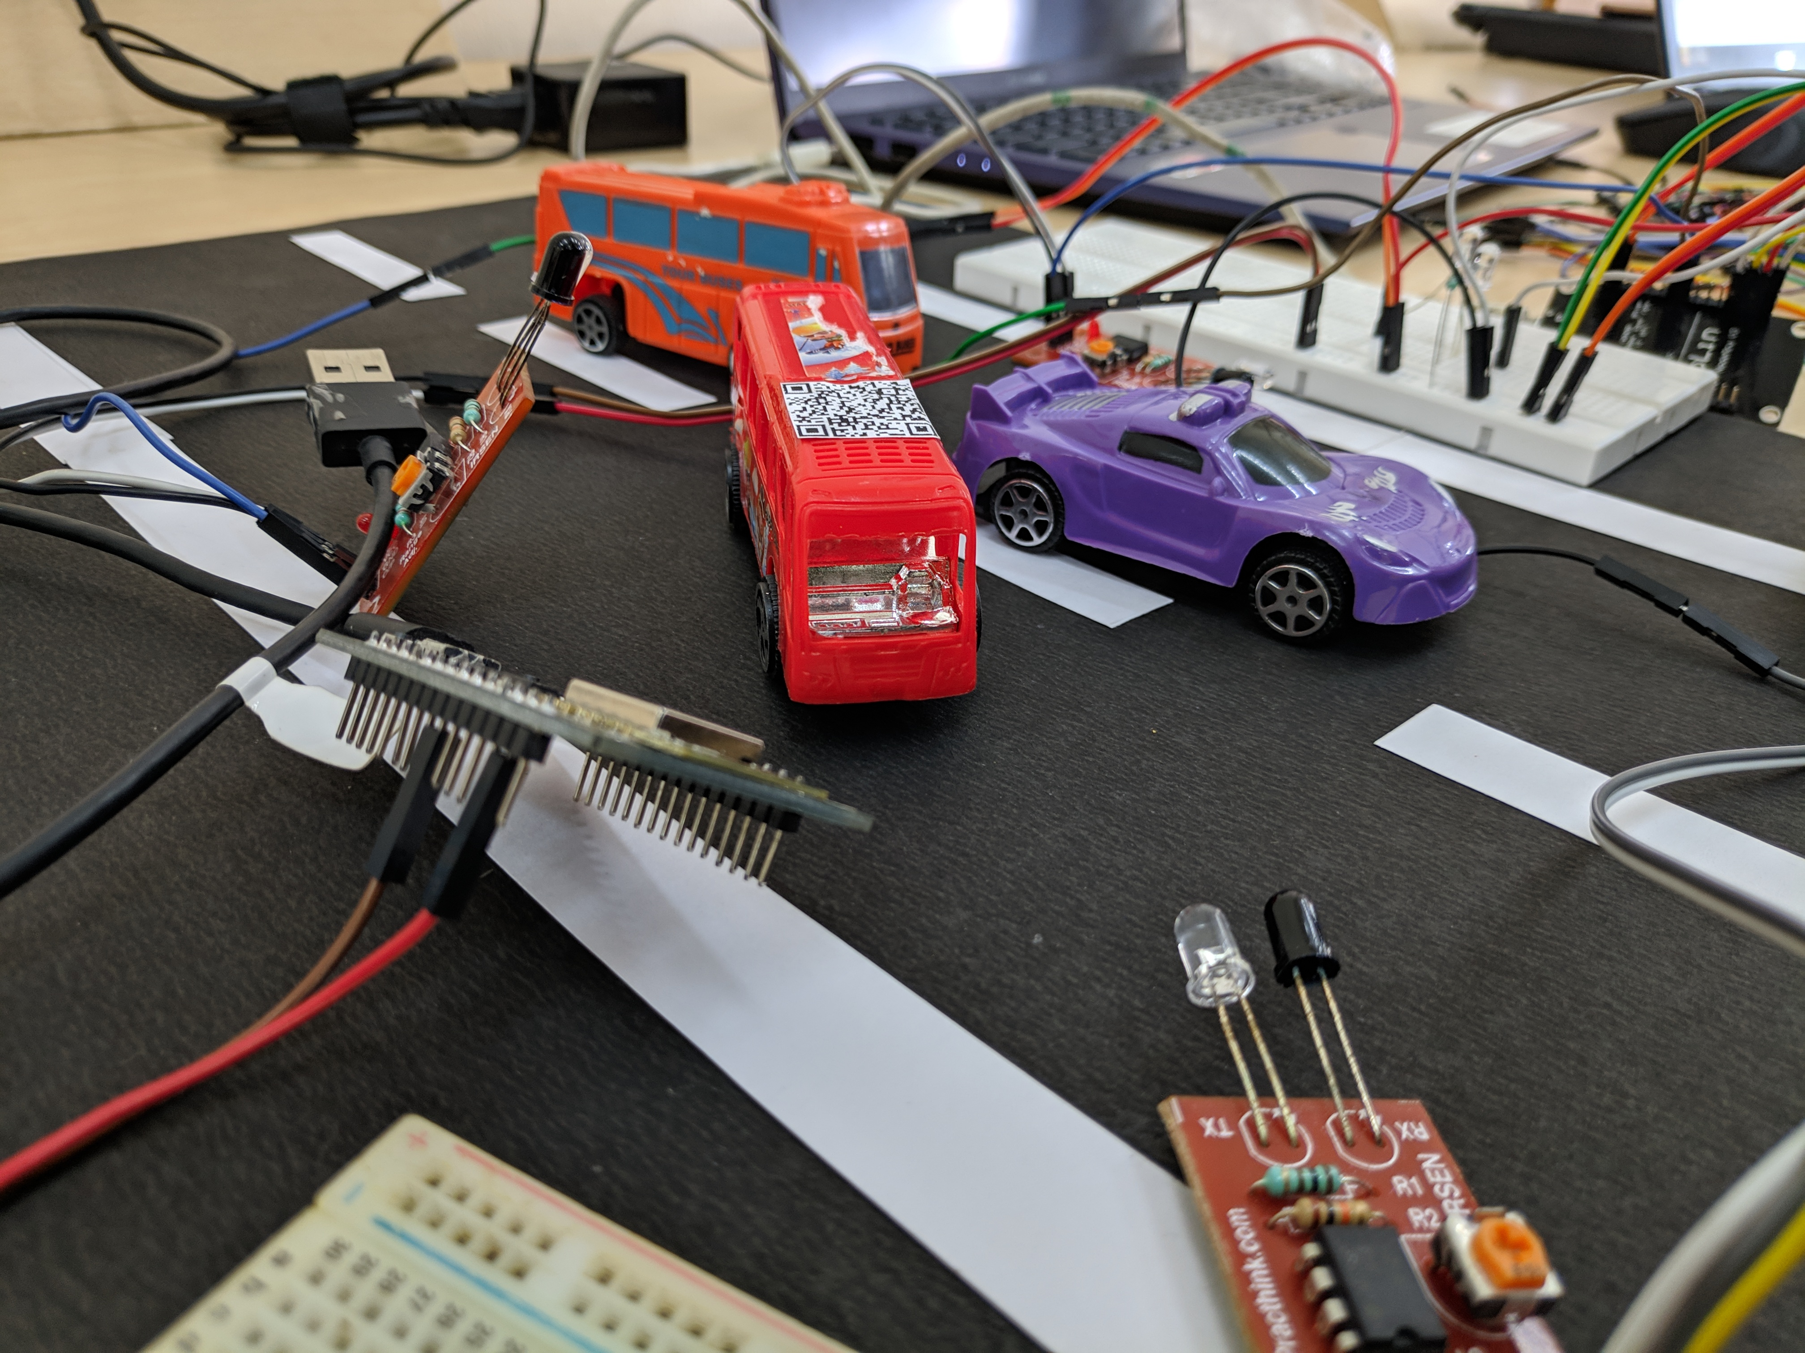
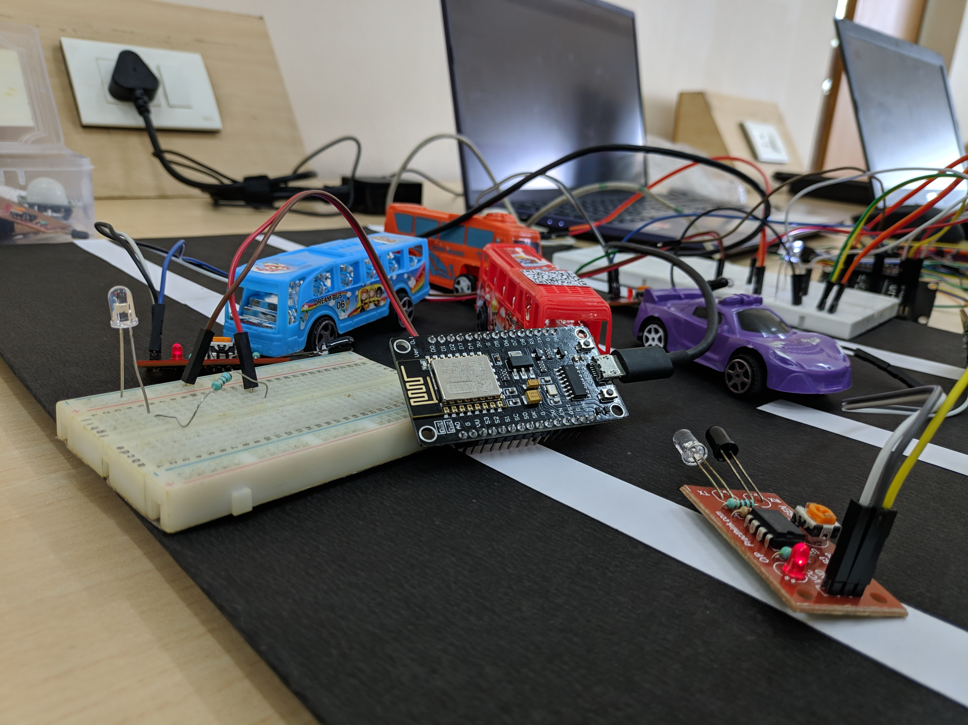
Glimpses

Slide 18

We want to implement machine learning in our project for image recognition of RFID in car by which we can get the owner info from database and send the message of penalty to owner and he can pay online but to get the receipt he need to visit RTO office .
We can also pay online toll tax.

Slide 19
THANK YOU
FOR LISTENING AND WATCHING

